Slide 1
Consumers/retailers communication and safety tracker while visiting to retailers
A perfect app to help mankind during lockdown in times of pandemic
Fight to COVID-19
Team MGM
Uttam Ghorai(536631)
Sourya Dasgupta(761355)

Slide 2
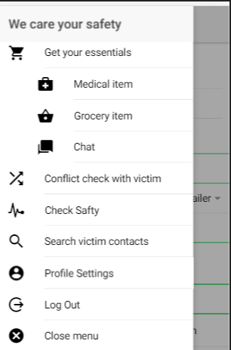
Problem statement
Due to lockdown and shortage in supply, all essential items are not available to all retailer and all retailer are not available everyday.
Customer don't know with item is available where or retailer is available for the day or not and they visit one retailer to another retailer to get any essential item.
While visiting those places they don't know whether those places are safe for them or not?
Also customers will not get to know whether they have conflicted with a victim or not ?
Solution
Our Idea is to provide a platform where customers and retailers can communicate with each other and care about customers safety while they visit to retailers.

Slide 3
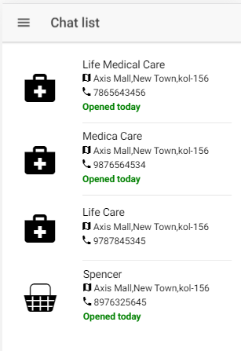
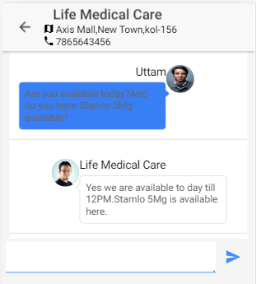
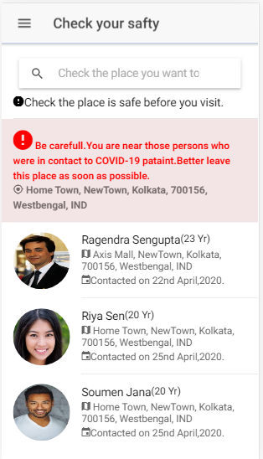
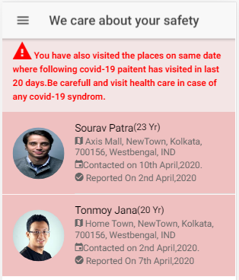
Solution con..
Consumer-Retailer communication
Check place is safe before
Visit to retailer
Check you have conflicted with any victim in last 20 days or not
System Notification for consumer safety

Slide 4
How to Implement:
Provide a chat communication between consumers and retailers.
When users will visit any places it will save there visit location like shopping mall, bus stand , office etc. by date.
When any of those user say XXXX mark as effected by covid-19, then The system will notify other users who has visited the same places as the victim has visited on same date. Also we can easily identify the persons who might be in touch of a victim.
When the persons who were in contact with a victim, will visit any place the system will notify others who are in same place .
Before visiting any place user can check online whether that place is safe for them or not.

Slide 5
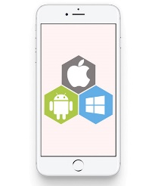
Technology stack:
REST API
Chat server
IONIC – Front end
Node JS – Chat server
Spring boot – Back end
FSM – Notification
MySQL – Database
DB
Cloud Messaging

